Slide 1
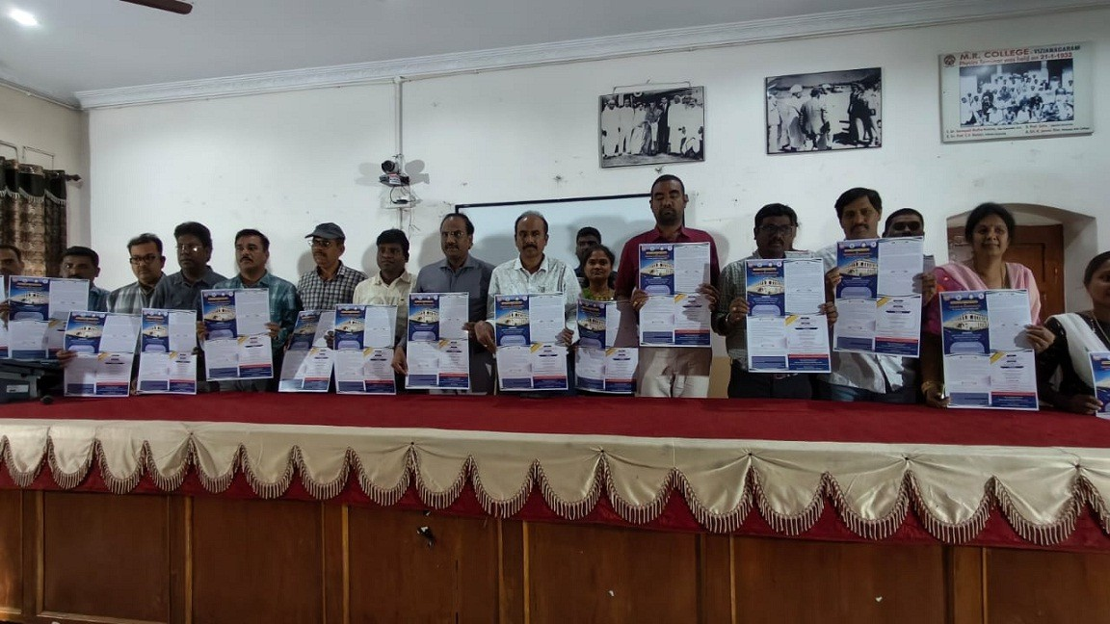
Workshop on Trends in Mathematics
Poster Releasing

Slide 2
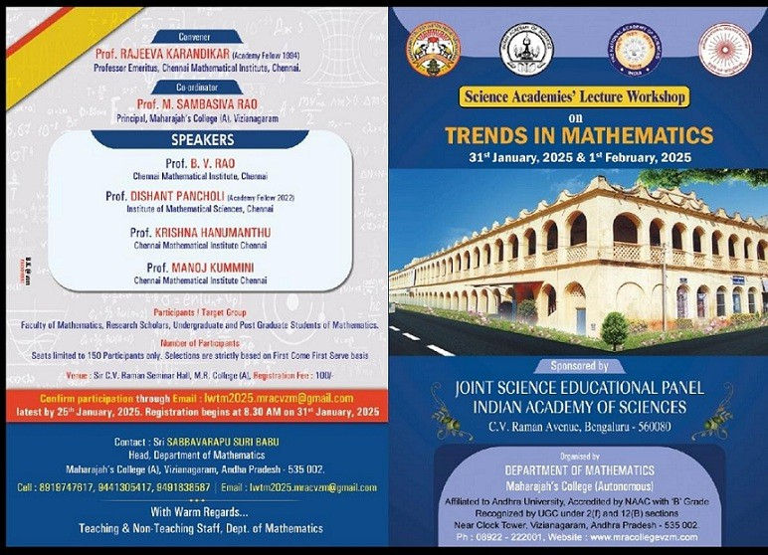
Workshop on Trends in Mathematics
Brochure 1/2

Slide 3
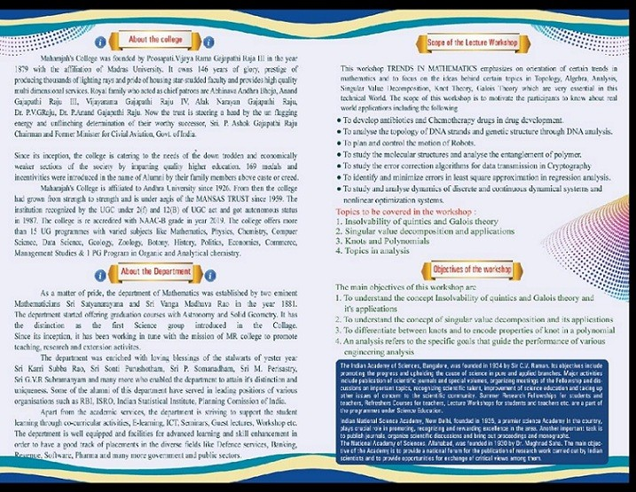
Workshop on Trends in Mathematics
Brochure 2/2

Slide 4
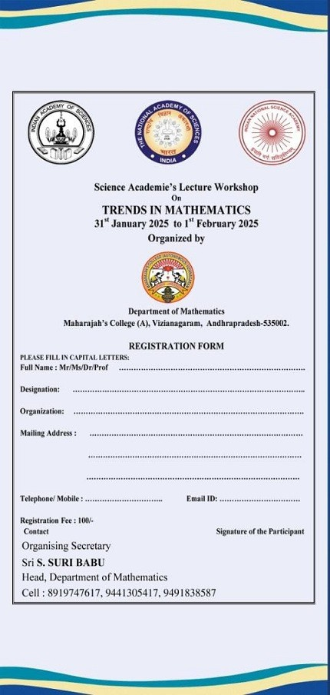
Workshop
on
Trends in Mathematics
Form for Registration

